Slide 1
Friedrich-Schiller-
Universität Jena
Grantee programme: Erasmus+ / International Dimension
TSU, Tbilisi, 30.11.2015

Slide 2
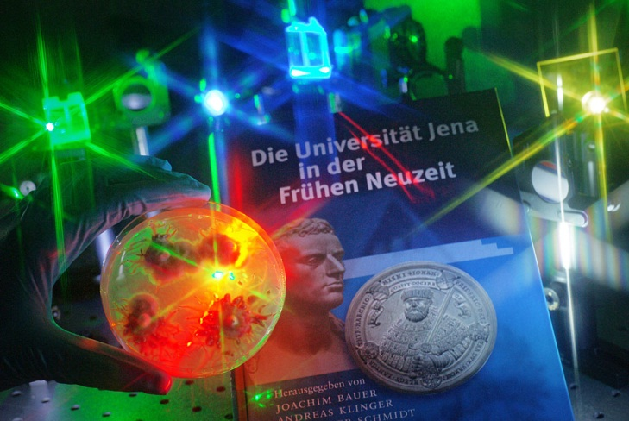
Self-understanding
University with long tradition – founded in 1558
Only full-spectrum university in Thuringia (10 faculties)
Highly interdisciplinary approach and interconnectedness
among faculties and with non-university research institutes
Close connections to the industry
and cultural institutions
Jena – “Staple town of science
and scholarship”
Cooperation of universities in
Halle – Jena – Leipzig
Figures 2014
  19,000 students
  3,400 doctoral candidates
  7,900 employees
  375 professors

Slide 3
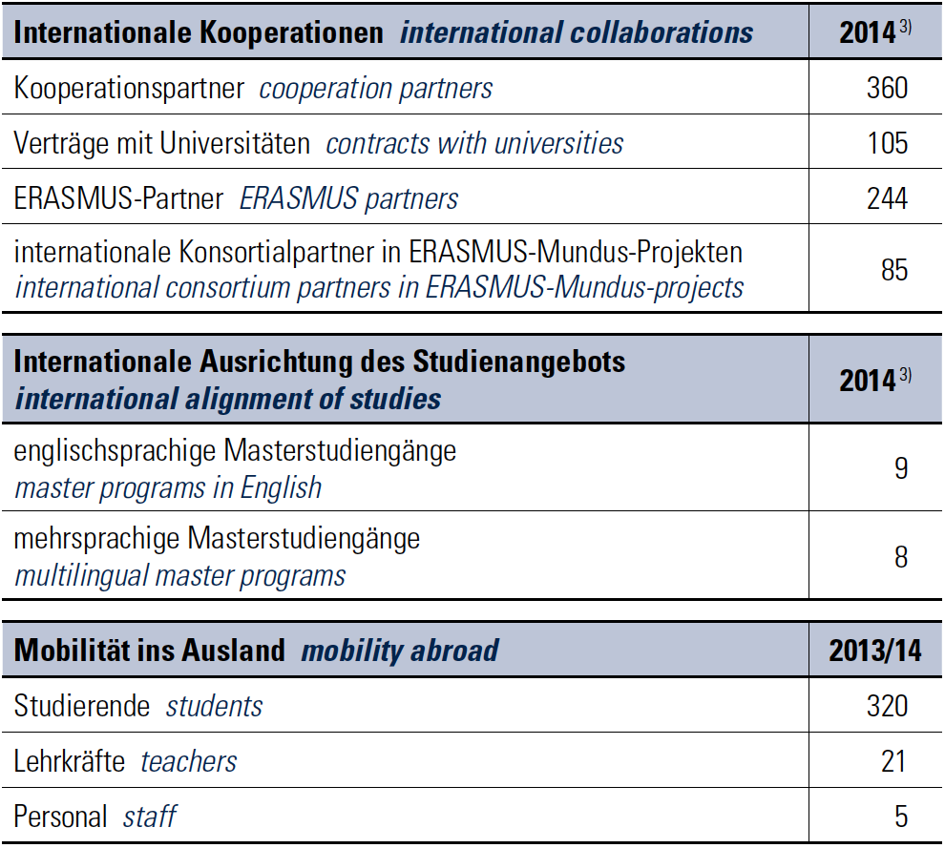


Friedrich Schiller University international
³⁾ review period: calendar year
Notes:
Die Universität Jena bietet viele Masterprogramme auf Englisch und Deutsch in Kombination an.
Reine englischsprachige Masterprogramme sind in den Naturwissenschaften und Wirtschaftswissenschaften zu finden. Sie sind sehr forschungsorientiert und bereiten die
Masterstudierenden auch auf PhD positions vor.
Weiterhin bieten wir zahlreiche Austauschmöglichkeiten für ihr Studium an anderen europäischen Hochschulen welt weit an.
Bis zu 400 Studierende gehen mit Erasmus und anderen Programmen jedes Jahr ins Ausland.
Neben den Masterprogrammen bieten wir Graduiertenschulen sowie eine in Deutschland fast einzigartige Betreuung aller PhD-students
In der Graduiertenakademie.
Zu diesen Studiengängen zählen:
Biochemistry
Economics
Evolution, Ecology and Systematics
Microbiology
Molecular Life Sciences
Molecular Medicine
Und Photonics
M.Sc. Studies in Economics

Slide 4
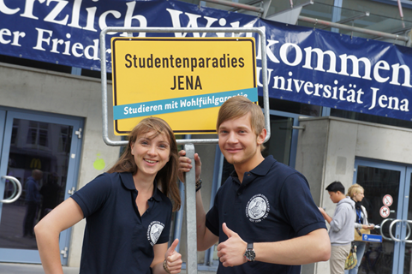
General Information about Erasmus+ / International Dimension
The ERASMUS+ programme / International Dimension:
grants scholarships to individuals
to come and study or do research at almost all academic departments and disciplines offered at the FSU
target group: guest students (Bachelor and Master-Level),PhD-candidates and staff,
Grant: monthly scholarship + travel expenses for the round trip
Only Applicants from Georgian are entitled to apply

Slide 5
Study Fields involved (Bachelor, Master, PhD)
Economics (BA: German, MA: English)
Political Sciences (BA + MA: both: German+ English)
Languages (BA + MA: German, English, Slavonic, Caucasian Studies)
Law (LLM – MA)
Ecology (BA: German, MA: English)
Biology (BA + MA: English)
Ancient Sciences (BA + MA: German)
History (BA + MA: German)
Psychology (BA: German)
Sociology (BA + MA: German)

Slide 6
Recognition and Credit System
As in the Erasmus+ programme for Europe, students earn credit points (ECTS) that will be recognized and credited by the home university according to the Bologna agreement
More information at: https://www.uni-jena.de/en/ECTS_information.html

Slide 7
Duration of stay abroad:
Level | Duration:
Bachelors | 5 months and 10 months
Masters | 5 months and 10 months
PhD | 3, 6 and 10 months
Staff | 2 weeks up to 2 months
All mobility opportunities for students of Bachelors and Masters programmes are linked to the duration of the Summer term 2016 and the winter term 2016/17 at the FSU.

Slide 8
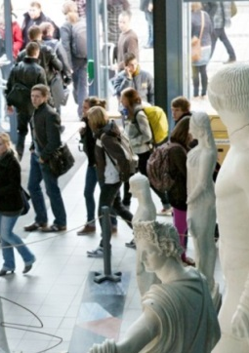
Duration of stay abroad
Summer term 2016: lecture period:
1 April 2016 – 31 August or 30 September 2016
Winter term 2016/17: lecture period:
1 October 2016 – 28 February 2017 or 31 March 2017
Due to the duration of the programme, 10-months scholarships can only be granted starting with the summer term 2016
For the winter term 2016/17, ONLY 5 month scholarships can be granted.
All stays abroad must be completed by 31 May 2017 at the latest.

Slide 9
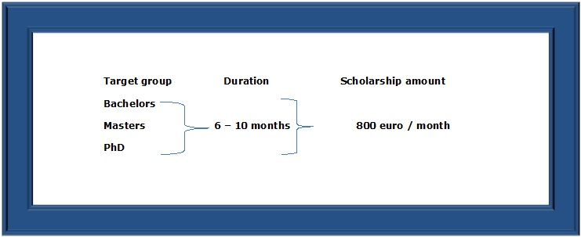
Scholarships:

Slide 10
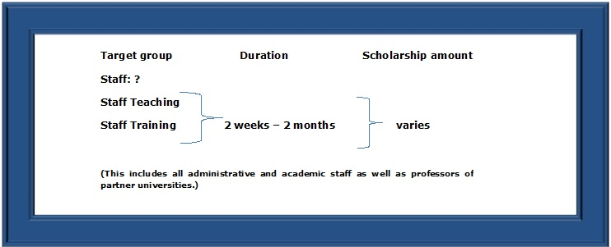
Scholarships:

Slide 11
Application Details
Applications for the Erasmus+ International Dimension programme should be send by the 15.12.2015 to the:
Department of Foreign Relations:
Erasmus+ Officer
erasmusplus@tsu.ge

Slide 12
Documents:
The following documents are required:
• CV (https://europass.cedefop.europa.eu/de/documents/curriculum-vitae)
• Scanned copy of passport or identity card
• Letter of motivation
• letter of recommendation
• ToR
• language certificates (English Certificate B2 According to CEFR / CEFR; IELTS 6.0 TOEFL 72 (IBT), Cambridge First Certificate in English, German B2 According to CEF / CEFR, Goethe certificate B2; TestDaF: minimum 4x3, DSD I or II, DSH-1 or DSH 2) – can also be provided by the TSU language center
• List of publications (PhD and academic mobilities)
• invitation letter by academic supervisor (for PhDs)
• invitation letter by academic or administrative supervisor (for staff training/teaching)
• Proof of employee status or proof of enrollment
• Learning Agreement or Research Plan (more information at https://www.uni-jena.de/onleila/cgi/?x=lqh0tKfMl4y*ZEokU0P7DQ)

Slide 13
Application Period:
Target group students (Bachelors, Masters, PhD)
For the summer term 2016: 15 Dec 2016
For the winter semester 2016/17: 15 May 2016
Final selection results will be announced via mail : 30.12.15 – 4.1.16
Necessary for all selected students: online registration at FSU Jena: 4.1. – 15.1.16
Target group Staff:
Applications can be submitted at all time on the basis of a confirmation by the academic supervisor at FSU Jena

Slide 14
More information about English-taught Masters programmes :
http://www.master.uni-jena.de/en/Graduate+studies/Master+of+Science/English+taught+Master_s+Programmes-p-194.html
General informations about FSU in English:
http://www.uni-jena.de/en/start.html
Notes:
Alle wichtigen Informationen zu unseren englischsprachigen Masterprogrammen finden Sie unter:
(Siehe Link)

Slide 15


Friedrich Schiller University Jena International Office
Project Coordinator
Stefanie Waterstradt
E-mail:
Stefanie.waterstradt@uni-jena.de
Mail:
Fürstengraben 1
D- 07743 Jena
Germany

